Slide 1
ADVANCING KIDNEY HEALTH WORLDWIDE. TOGETHER.

Slide 2

ABOUT ISN
A global professional association dedicated to advancing kidney health worldwide since 1960
Engages 30,000+ health professionals from across the globe to reduce the burden of kidney diseases and provide optimal health care for patients
60 YEARS OF ADVANCING KIDNEY CARE WORLDWIDE.
One World. One ISN.

Slide 3


VISION
OUR VISION
A future where all people have
equitable access to sustainable
kidney health.
- About

Slide 4



MISSION
BRIDGING THE GAPS
BRIDGING
THE GAPS
of available care through advocacy and collaborations with our global partners
BUILDING CAPACITY
BUILDING CAPACITY
CONNECTING OUR COMMUNITY
in healthcare professionals through granting programs, education, and research
to develop a stronger understanding of the best ways to manage kidney diseases
CONNECTING OUR COMMUNITY
- About

Slide 5






THE ISN COMMUNITY
ISN MEMBERS WORLDWIDE
9,000
113
Members
Affiliated
societies
27
165
Collective societies
Countries
- About
Notes:
Check on number of affiliated societies – should be 110/111
Remove 50% are under 45 and 2600 new members
Remove bar graph
World map – what do red dots represent?

Slide 6
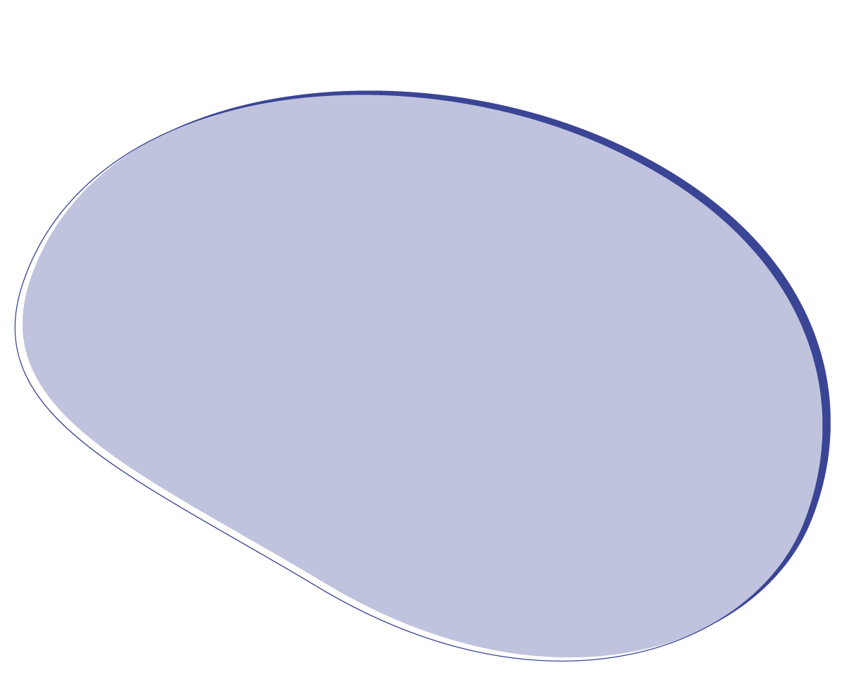




JOIN THE ISN
THE ISN BELIEVES IN EQUITABLE ACCESS TO MEMBERSHIP
Advance your profession
Trainees: first year FREE,
then $15/year next four years while in training
Medical doctors, and allied health professionals, from Low Income countries: Join for FREE
Medical doctors, and allied health professionals with PhDs, from Lower-Middle and Upper-Middle Income countries: New reduced fees
Allied Health Professionals: Join for $45
Make a difference
Connect globally
One world. One ISN.
Start your journey at
theisn.org/membership
- About

Slide 7


ISN OFFERS JOINT GROUP MEMBERSHIP TO ALL
All World Bank income groups (lower-middle, upper-middle, high-income) are now eligible to register for
ISN Joint membership.
Members from the same income category can renew or join the ISN as a group of five members at a fixed discounted fee and save up to 15% on their annual dues.
theisn.org/membership
Notes:
Check with Miriam – if keeping it, then placement of slide is not correct – should go earlier

Slide 8

SUPPORT THE GLOBAL KIDNEY COMMUNITY AS AN ISN MEMBER
Advance
your profession
ISN Membership supports grants and activities to advance kidney health worldwide
Make a difference
One world. One ISN.
Connect globally
Start your journey at
theisn.org/membership
- About

Slide 9



FELLOW OF THE ISN (FISN)
Fellow of the International Society of Nephrology (FISN): a status granted to ISN members who have demonstrated outstanding professional accomplishments and contributions to the specialty of kidney care.
APPLICATIONS ARE OPEN EVERY YEAR
  from October 1 to November 30
theisn.org/fisn
For more information contact info@theisn.org

Slide 10







ISN GRANTS & PROGRAMS
In the last decade, the ISN has supported:
v
V
V
V
V
281
53
422
136
223
Doctors (fellows)
who trained and returned home to grow as local leaders in
clinical research projects focused on early kidney disease detection programs in
local educational (CME) meetings training local nephrology workforces in
Educational
ambassadors
to deliver expert
hands-on training in
Sister center partnerships in​
72 countries
21 countries
86 countries
55 countries
70 countries
+ 5 scientific writing courses
$15,5 million invested in LMICs for a future with equitable access to sustainable kidney health
- In action

Slide 11


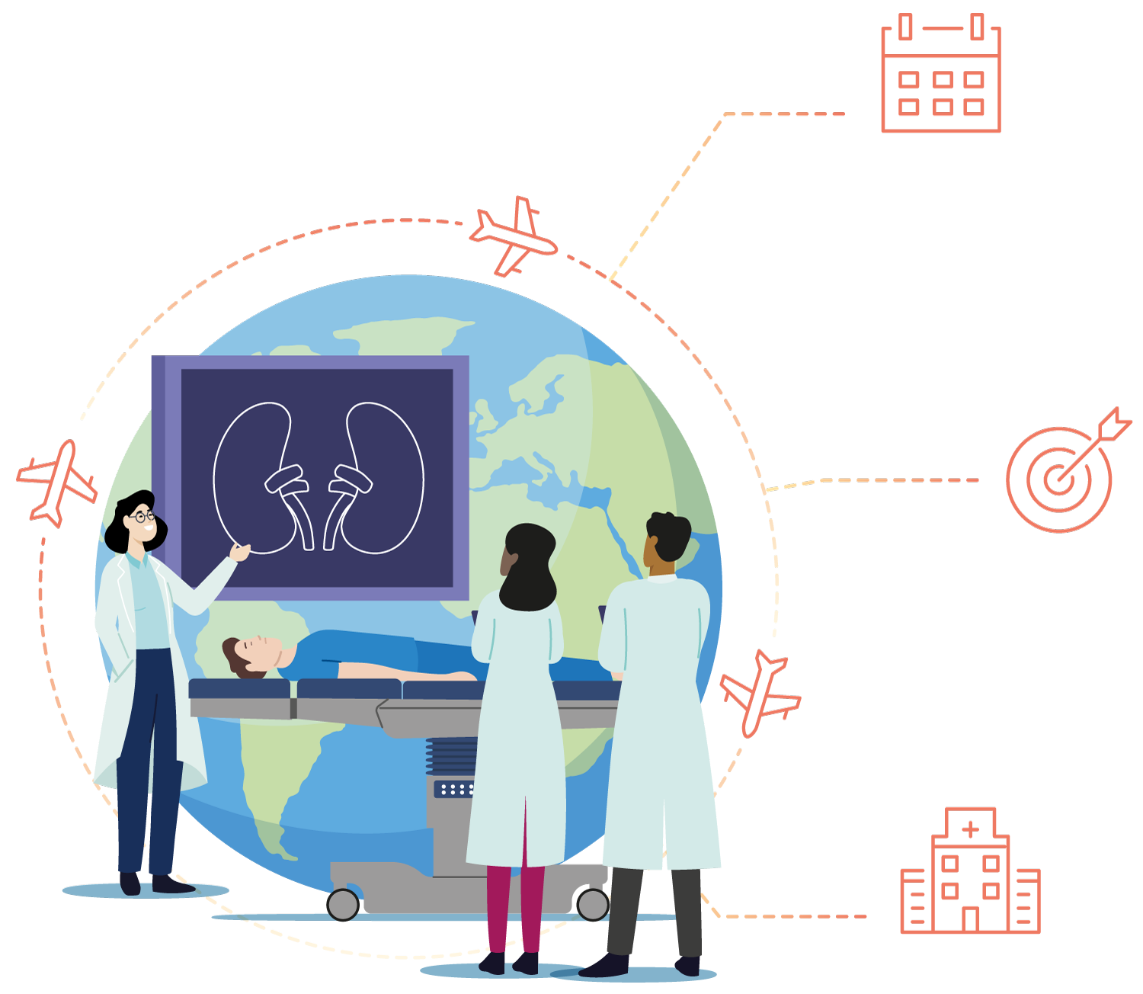
ISN FELLOWSHIPS
GAIN THE SKILLS MOST NEEDED IN YOUR COMMUNITY
The ISN Fellowships are highly customizable to offer training that is effective, accessible, and relevant.
CHOOSE YOUR DURATION
THERE ARE TWO CALLS
FOR APPLICATION EVERY YEAR:
  May 1
  October 1
CHOOSE YOUR FOCUS
theisn.org/fellowship
CHOOSE YOUR CENTER
Or contact fellowship@theisn.org
- In action
Notes:
Too text-heavy – okay not to include every detail

Slide 12
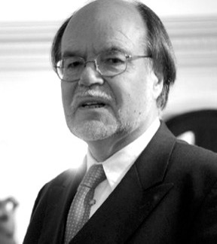
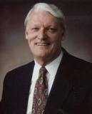
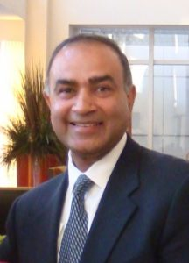
ISN FELLOWSHIP DONATION FUNDS
Detlef Schlöndorff Fund
Schrier Fellowships Fund
Ravi Mehta AKI Fellowship Fund
Launched in Dec. 2019
4 fellows so far
Set up in 2006
56 fellows so far
Launched in Feb. 2020
2 fellows so far
Thanks to your contributions, we fund more fellows
www.theisn.org/Donate
- In action

Slide 13



INTERVENTIONAL NEPHROLOGY SCHOLARSHIPS
The Interventional Nephrology Scholarship Program offers a two-part training program:
An online e-learning curriculum on the ISN Academy
Up to three months of on-site training at one of twelve Interventional Nephrology Training Centers
ANNUAL DEADLINE:
  June 1
theisn.org/in
For more information contact programs@theisn.org or visit www.theisn.org/in
- In action

Slide 14



ISN CLINICAL RESEARCH
The ISN Clinical Research Program provides funding for members to carry out screening and research projects addressing local issues in kidney care.
ANNUAL DEADLINE:
  May 1
theisn.org/cr
For more information contact crp@theisn.org or visit www.theisn.org/cr
- In action

Slide 15




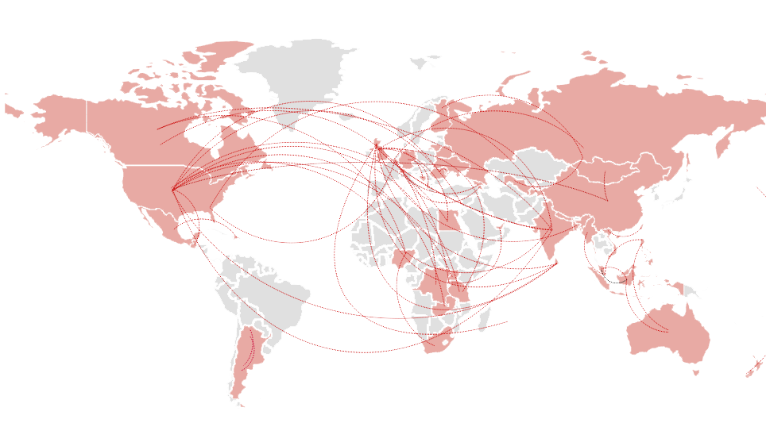
ISN SISTER CENTERS
ISN SISTER RENAL CENTERS (SRC)
Build partnerships of excellence.
ISN-TTS SISTER TRANSPLANT CENTERS (STC)
Develop and enhance transplantation
services through
ANNUAL DEADLINE:
ANNUAL DEADLINE:
  SRC: October 1
  STC: October 15
Discover the Sister Centers Program:
theisn.org/src
- In action

Slide 16


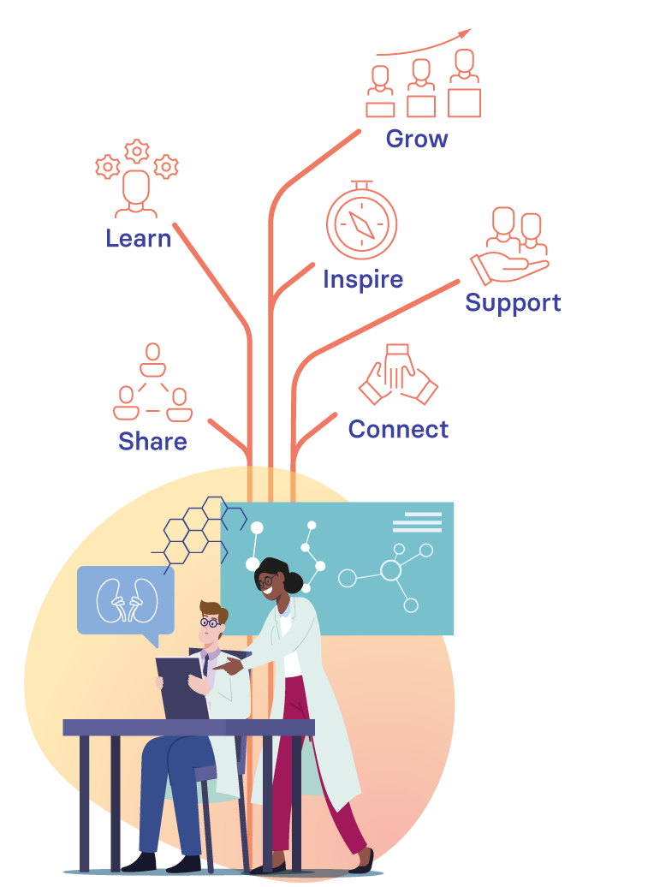
ISN MENTORSHIP
The ISN Mentorship Program links mentees looking for guidance on specific professional goals and mentors willing to help them achieve their objectives and, in the process, develop their own coaching and leadership skills.
theisn.org/mentorship
The ISN Mentorship Program is open to all ISN members and
associate members.
DEADLINES TO APPLY
  Mentees:
  July 1
  Mentors:
  March 1
- In action

Slide 17



ISN EDUCATIONAL AMBASSADORS
Receive expert guidance and hands-on training in your center for up to 4 weeks.
    Apply all year round
    (minimum three months prior to the training)
theisn.org/ea
For more information contact eap@theisn.org or visit www.theisn.org/ea
- In action

Slide 18



ISN CONTINUING MEDICAL EDUCATION
The ISN Continuing Medical Education Program supports and helps to select faculty to present talks and workshops at regional meetings.
theisn.org/cme
    Apply all year round
    (at least three months before the meeting date)
For more information contact cme@theisn.org or visit www.theisn.org/cme
- In action

Slide 19



ISN EMERGING LEADERS
Acquire and develop the skills and knowledge
to become the leaders of tomorrow!
theisn.org/elp
Applications are open every two years
  September 30, 2023
NEXT DEADLINE:
For more information contact elp@theisn.org or visit www.theisn.org/elp
- In action
Notes:
This program provides early-career professionals in integrated kidney care the opportunity to work with international experts in the field to become qualified for a leadership role in the advancement of global kidney care.
Intending to build a global talent pool of future leaders, the ELP welcomes ISN members interested in shaping the direction of kidney health to ensure health promotion and access to prevention, control, and management of kidney diseases.
This is a collaborative initiative bringing together outstanding individuals to work on collective projects to impact the kidney health agenda worldwide.
The program offers participants guidance in:
principles of entrepreneurship, advocacy, and communication;
implementation science and research;
evaluation, development, and management of health systems;
developing and implementing evidence-informed policy;
influencing stakeholders including policymakers, funders, implementers and the media.
The program provides the opportunity to
Join a global network that positively impacts the kidney health agenda worldwide through collaboration and multidisciplinary research;
Learn to be heard and effect change at local and international levels;
Access continuous professional development to take on leadership roles locally and globally.

Slide 20


ISN SCIENTIFIC WRITING COURSE
The ISN Scientific Writing Course is geared to help physicians and researchers in nephrology obtain the skills needed to publish their research work.
Follow our website for upcoming courses
theisn.org/swc
For more information contact swc@theisn.org or visit www.theisn.org/swc
- In action

Slide 21
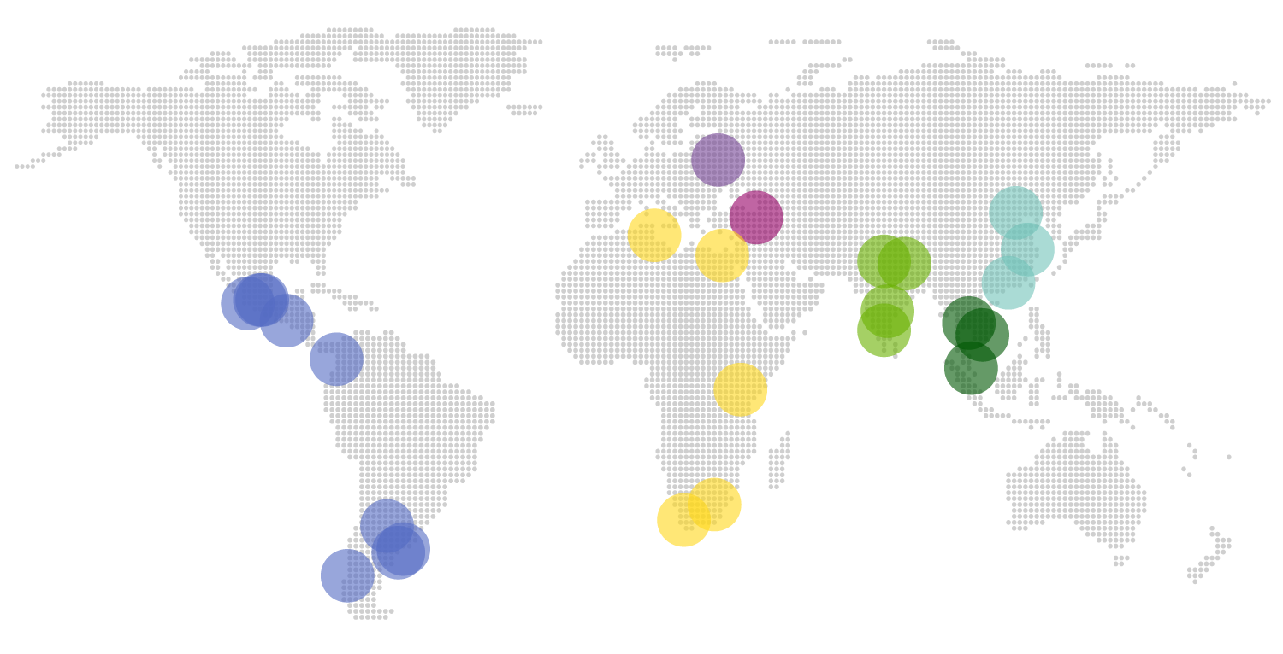
ISN REGIONAL TRAINING CENTERS
ISN Regional Training Centers are key partners in advancing kidney care locally.
Discover the Regional Training Centers:
theisn.org/rtc
- In action

Slide 22

















PARTNERS/ SUPPORTERS ISN GRANT PROGRAMS
Corporate support
Corporate support
- In action
Notes:
ISN grant programs are supported by more than the 2 companies noted

Slide 23





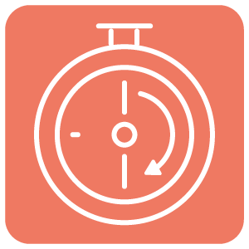



EDUCATION
KIDNEY CARE E-LEARNING AT YOUR FINGERTIPS
What do you want to learn today?
LATEST RELEASES
LIVE and ON-DEMAND WEBINARS
“30 MINUTES OR LESS”
COURSES and CURRICULUM
academy.theisn.org
ISN MEETINGS
OPEN-ACCESS RESOURCES
- In action

Slide 24


EDUCATION: WEBINARS
The ISN provides regular live and recorded webinars in several languages covering a range of topics relevant to the nephrology community
Webinars are produced by ISN and, also
in partnership with other leading organizations
KIDNEY HEALTH EDUCATION FOR GLOBAL IMPACT
academy.theisn.org
- In action

Slide 25


KIDNEY CARE ETHICS RESOURCES
Curated to help you identify sources of advice and insights in ethical challenges in kidney care, and encourage active participation in addressing ethical issues.
academy.theisn.org
- In action

Slide 26

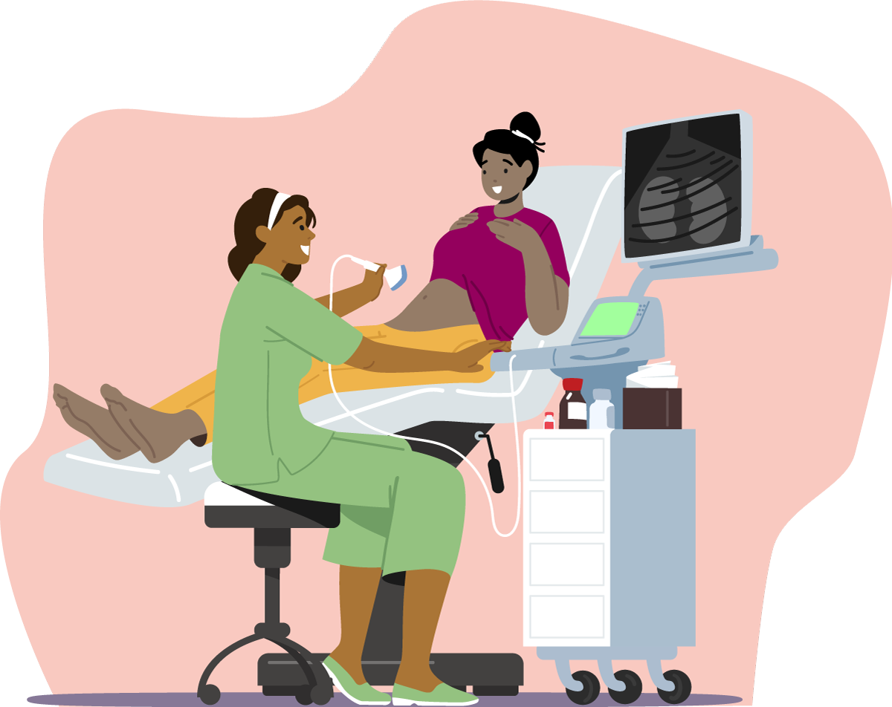

COURSE-BASED LEARNING
CURRICULUM:
Anemia of Renal Disease
CURRICULUM:
POCUS (point-of-care ultrasound)
Areas covered include:
POCUS examination is now considered standard procedure in many hospitals, adding a contemporary
examination tool to the
nephrologist's repertoire.​
Epidemiology of renal anemia
Pathophysiology of renal anemia
Mechanism of action of ESA
Trials of renal anemia
Metabolism
Iron trials
Iron formations
Targets
academy.theisn.org
- In action

Slide 27
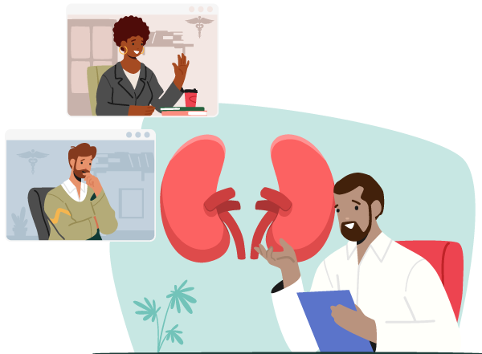
COURSE-BASED LEARNING
NEPHROLOGY CURRICULUM FOR NON-NEPHROLOGISTS
Presented in collaboration with the Mumbai Kidney Foundation
Twenty modules to equip primary care physicians with the necessary knowledge and skills to manage and care for patients with kidney-related issues.
Topics Include:
Glomerulonephritis
Hypertension
Acute kidney injury
Diabetic kidney disease
Pregnancy
Chronic kidney disease
Dialysis
Transplantation
Palliative care
academy.theisn.org
- In action

Slide 28




PRIMER OF RENAL PATHOLOGY
FOR EARLY-CAREERS
LECTURES
CASES
CURRICULUMS
… and many other resources available on
academy.theisn.org
- In action

Slide 29






PODCASTS: Global Kidney Care
Available on
Apple Podcast
Spotify
Stitcher
…and other podcast platforms​
globalkidneycarepodcast.transistor.fm
- In action

Slide 30














OUR KEY COLLABORATORS IN EDUCATION
- In action

Slide 31






SOCIAL MEDIA EDUCATION
The ISN Social Media team is comprised of healthcare professionals from all around the world to pursue online education with a particular focus on social media.
Offering:
visual abstracts,
video abstracts,
tweetorials,
Twitter Spaces,
live-tweeting
quizzes,
podcasts,
case discussions,
and much more.
#ThisIsISN

Slide 32

WCN’24
Notes:
We definitely need another slide on WCN’24 with deadlines and showing link to promo materials etc

Slide 33
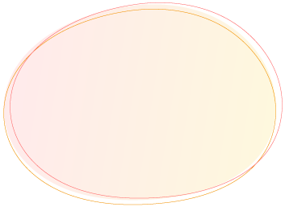







JOIN THE BRIGHTEST MINDS SHAPING THE FUTURE OF KIDNEY HEALTH
250
Global kidney experts speaking
75
Innovative scientific
sessions
130
Countries represented
4,000
Attendees
1,000
Posters
presented
IMPORTANT DATES
PRELIMINARY PROGRAM RELEASED
| September 2023
ABSTRACT SUBMISSION DEADLINE
| October 31, 2023
EARLY REGISTRATION OPENS
| October 2023
TRAVEL GRANT APPLICATION DEADLINE
| November 17, 2023

Slide 34




THE MOST GLOBAL AND ENGAGED NEPHROLOGY EVENT OF THE YEAR
TELL YOUR COLLEAGUES
– ¡Nos Vemos en Buenos Aires!
SPREAD THE WORD:
theisn.org/wcn/promotional-materials/

Slide 35

FILM EVENT

Slide 36


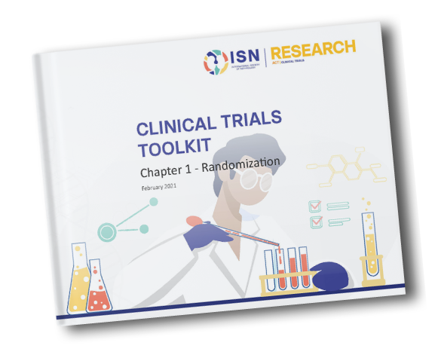
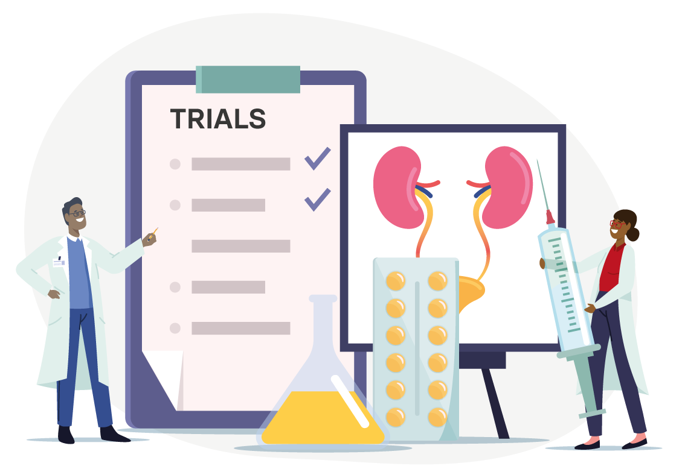
ADVANCING CLINICAL TRIALS (ISN-ACT)
Improving the global nephrology community’s participation in clinical trial research.
… and many other resources available on
theisn.org/research
ISN-ACT Clinical Trials Toolkit
CT Toolkit Narratives
Global Trials Focus
A series of stories based on various ISN-ACT Clinical Trials Toolkit topics
A monthly list of the latest notable randomized controlled trials (RCTs) from around the world selected by the ISN-ACT team

Slide 37

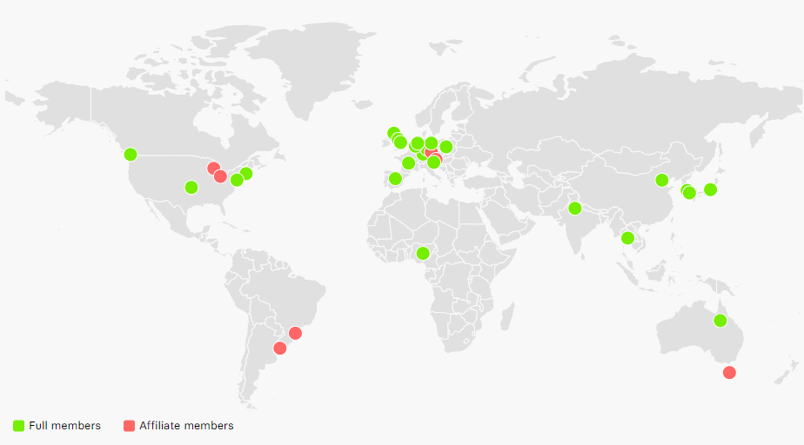
ISN iNET-CKD
A unique network of 32 cohort studies patient-level data and bio-samples
The ISN International Network of Chronic Kidney Disease cohort studies (iNET-CKD) facilitates collaboration between independently-funded CKD study investigators to improve understanding of CKD progression and its consequences.
ISN iNET–CKD studies worldwide
Africa (4 countries) | Europe (15 countries) | North America
H3Africa Kid Dis RN | 4C Europe (ped.) | CKiD (ped.)
Asia (5 countries) | BIS | CRIC
CKD-JAC | CKDOPPS Ger | AASK
C-Stride | CKD-REIN | CANPREDDICT
KNOW-CKD | Equal | CKDOPPS US*
KNOW-Ped CKD (ped.) | GCKD | LCKD*
ICKD | MERENA | South America
CORE-CKD | MMKD | NRHP*
Australia | NURTuRE-CKD | CKDOPPS Br
CKD.QLD | Provalid
CKD.TASlink* | PSI-BIND-NL
 | RIISC
 | RRID
 | Salford Kidney Study
 | SYSKID
theisn.org/research
*Affiliate Members
- In action

Slide 38

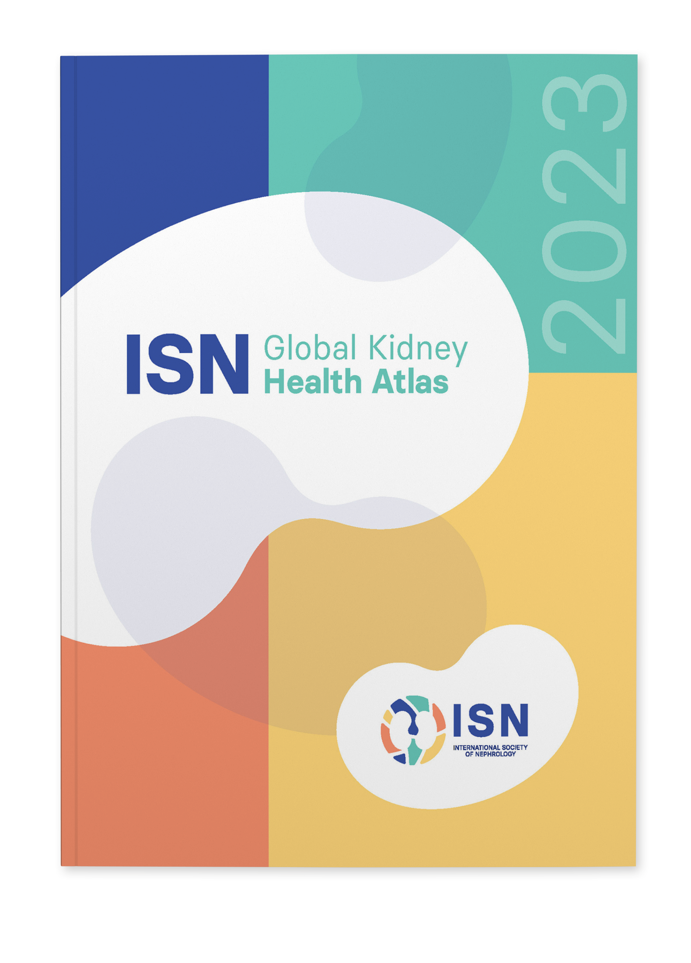
ISN-GLOBAL KIDNEY HEALTH ATLAS: ​
NEW 2023 EDITION NOW AVAILABLE
NOW AVAILABLE FOR DOWNLOAD:
the 2023 ISN-GKHA report & Region-specific summary slides
theisn.org/global-atlas
  KEY FEATURES OF 2023 EDITION:
    New! Perspectives on access and quality of care from people living
    with kidney diseases
    Data on kidney care organizations, structures and services worldwide (including funding, policies, guidelines, frameworks and workforce)
    Scorecards outlining resource and capacity trends of kidney care provision around the globe

Slide 39

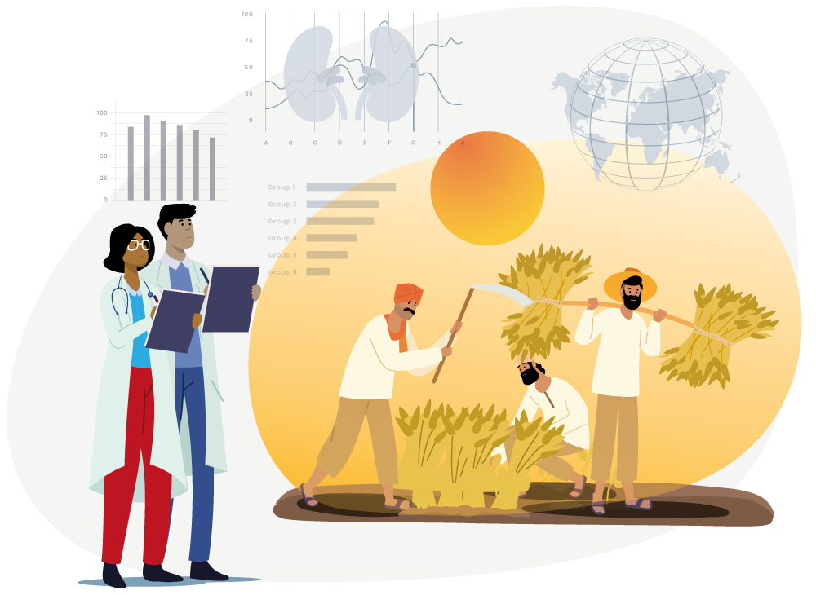
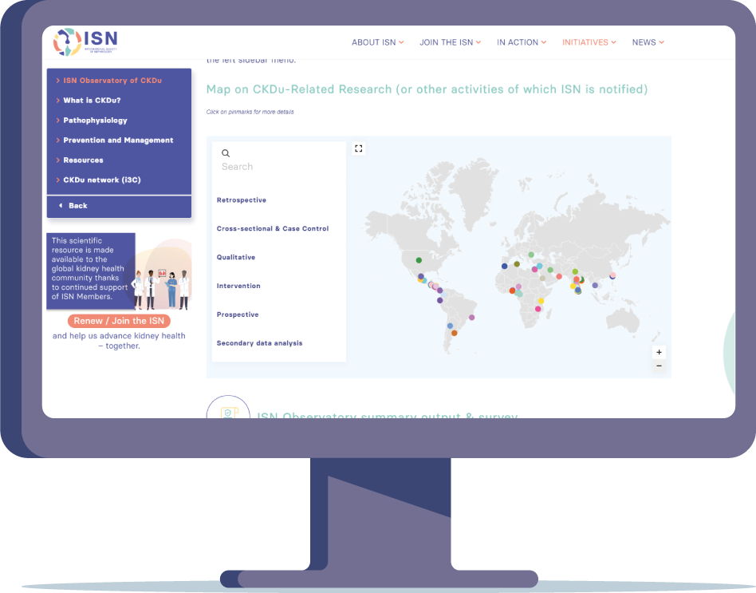
ISN OBSERVATORY OF CKDu
As part of its 2018-2022 Collaboration Plan with the World Health Organization, the ISN created the ISN Observatory of Chronic Kidney Disease of Unknown Etiology (CKDu) to facilitate the exchange of information and knowledge and raise awareness of CKDu.
Put your CKDu study on the map!
Visit
theisn.org/ckdu
- In action

Slide 40

SHARING EXPERTISE TO SUPPORT THE SET-UP OF RENAL REGISTRIES (SHARE-RR)
Registries play a vital role in defining disease burden and monitoring treatment and outcomes, but vary in coverage and structure. The ISN established “Sharing Expertise to support the set-up of Renal Registries” (SharE-RR), surveying 91 organizations worldwide managing renal registries and evaluated their approaches toward collecting, managing, and reporting data on people with kidney diseases.
Visit
theisn.org/SharE-RR
- In action

Slide 41


ISN's WORK WITH THE WHO
The ISN is a non-state actor (NSA) in official relations with the World Health Organization (WHO).
The ISN has a Collaboration Plan – running from 2021-2023 -with the WHO to deliver six research and advocacy-related projects addressing the global burden of kidney diseases within the context of global, regional, and national noncommunicable disease (NCD) strategies.​
​
​
As an NSA, the ISN works to raise kidney disease from neglected NCD to priority
Visit:
theisn.org/advocacy
- In action

Slide 42

PATIENT LIAISON ADVISORY GROUP
Ensure that the patient perspective is coherently integrated within the ISN’s work.
MISSION STATEMENT
To advise and guide the ISN toward embedding the patient perspective within all the ISN's kidney care and research initiatives and better tackle the global burden of kidney disease.
theisn.org/plag
- In action

Slide 43


THE ISN PROFESSOR DONAL O’DONOGHUE
GLOBAL KIDNEY POLICY FORUM
The ISN Professor Donal O’Donoghue Global Kidney Policy Forum is a
high-level meeting organized by the ISN at each World Congress of Nephrology (WCN).
  It brings together key decision-makers and stakeholders to address:
  the burden of kidney diseases in a specific country or region
  share strategies for the prevention and improved management of the disease at both regional and global levels
theisn.org/gkpf
- In action

Slide 44

WORLD KIDNEY DAY (WKD)
THE INITIATIVE
WKD is a joint initiative between the ISN and the International Federation of Kidney Foundations – World Kidney Alliance (IFKF- WKA)
SUPPORT
GOALS
www.worldkidneyday.org
Create a WKD event
Follow and interact with WKD on Social Media
Subscribe to the WKD Newsletter
Share the message to raise awareness
WKD is a global campaign that aims to
Raise awareness of the importance of kidneys to overall health, and
Reduce the frequency and impact of kidney disease and its associated health problems worldwide
STRUCTURE
Held every year on the second Thursday in March
Each year WKD has a specific focus
The theme links to an overall vision of “Kidney Health for All”
- Initiatives

Slide 45


2024 campaign
HOW TO GET INVOLVED
Create a WKD event
Follow and interact with WKD on Social Media
Subscribe to the WKD Newsletter
Become a WKD champion
Share the message to raise awareness
Learn more
www.worldkidneyday.org
- Initiatives

Slide 46

DECLARATION OF ISTANBUL
The Declaration of Istanbul on Organ Trafficking and Transplant Tourism
was adopted in 2008 at an international meeting organized by
The Transplantation Society and the International Society of Nephrology.
The Declaration calls on the medical community to advocate to health ministries with a transplantation program to eliminate organ trafficking and transplant tourism.
http://www.declarationofistanbul.org/
- Initiatives

Slide 47

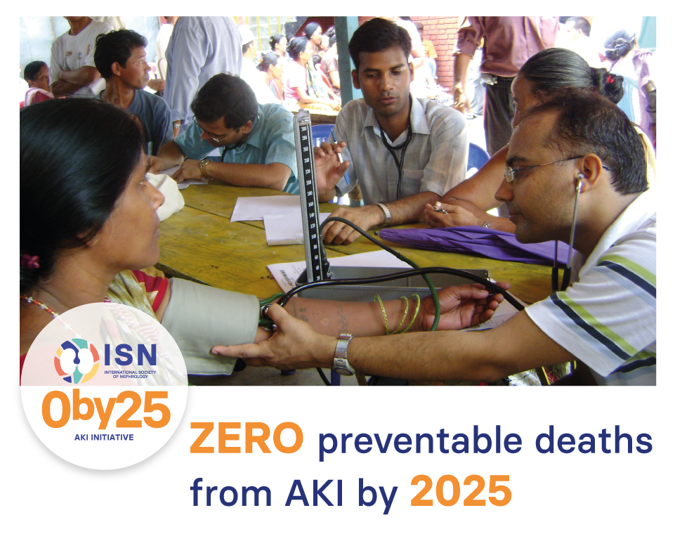
THE 0BY25 INITIATIVE
In 2013, the ISN launched the 0by25 Initiative which aims to eliminate preventable deaths from acute kidney injury (AKI) worldwide by 2025.
0by25 calls for global strategies to diagnose and treat AKI in patients with potentially reversible diseases, especially from within disadvantaged populations with poor access to care.
theisn.org/0by25

Slide 48




SAVING YOUNG LIVES
A partnership to deliver sustainable acute peritoneal dialysis (PD) for acute kidney injury in low-resource settings worldwide.
Saving Young Lives (SYL) focuses on providing training and educational activities in
low-resource communities to equip local health practitioners to identify and treat AKI cases needing hospital care
theisn.org/syl
SYL In Action
SYL has trained and supported 470 individuals in 42 different institutions from 26+ low resource countries to use PD as a treatment for AKI
SYL Impact
SYL has trained doctors and nurses who have treated over 500 patients with AKI using acute PD with a 65% survival rate
- Initiatives

Slide 49




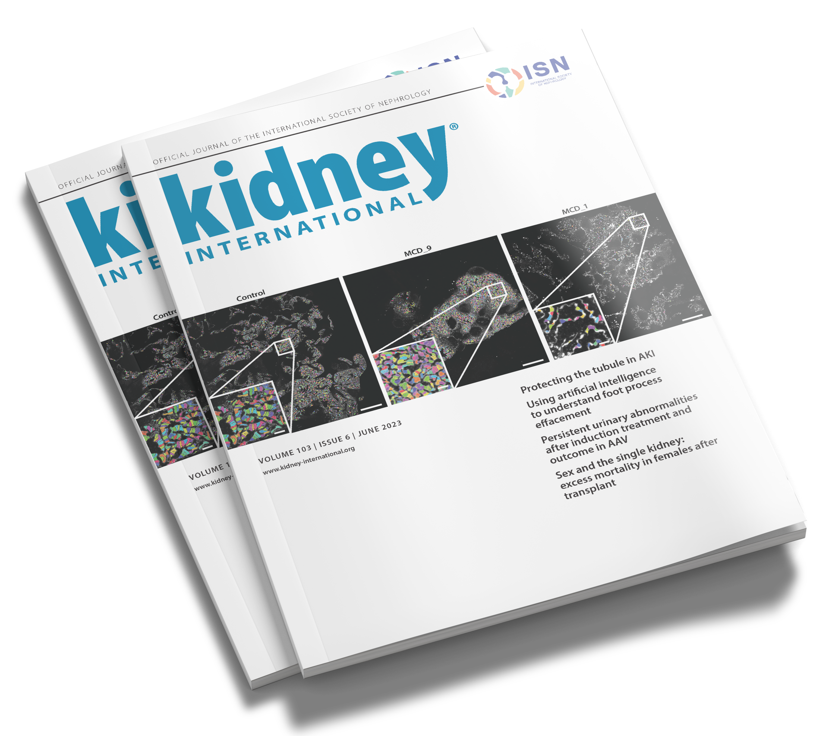
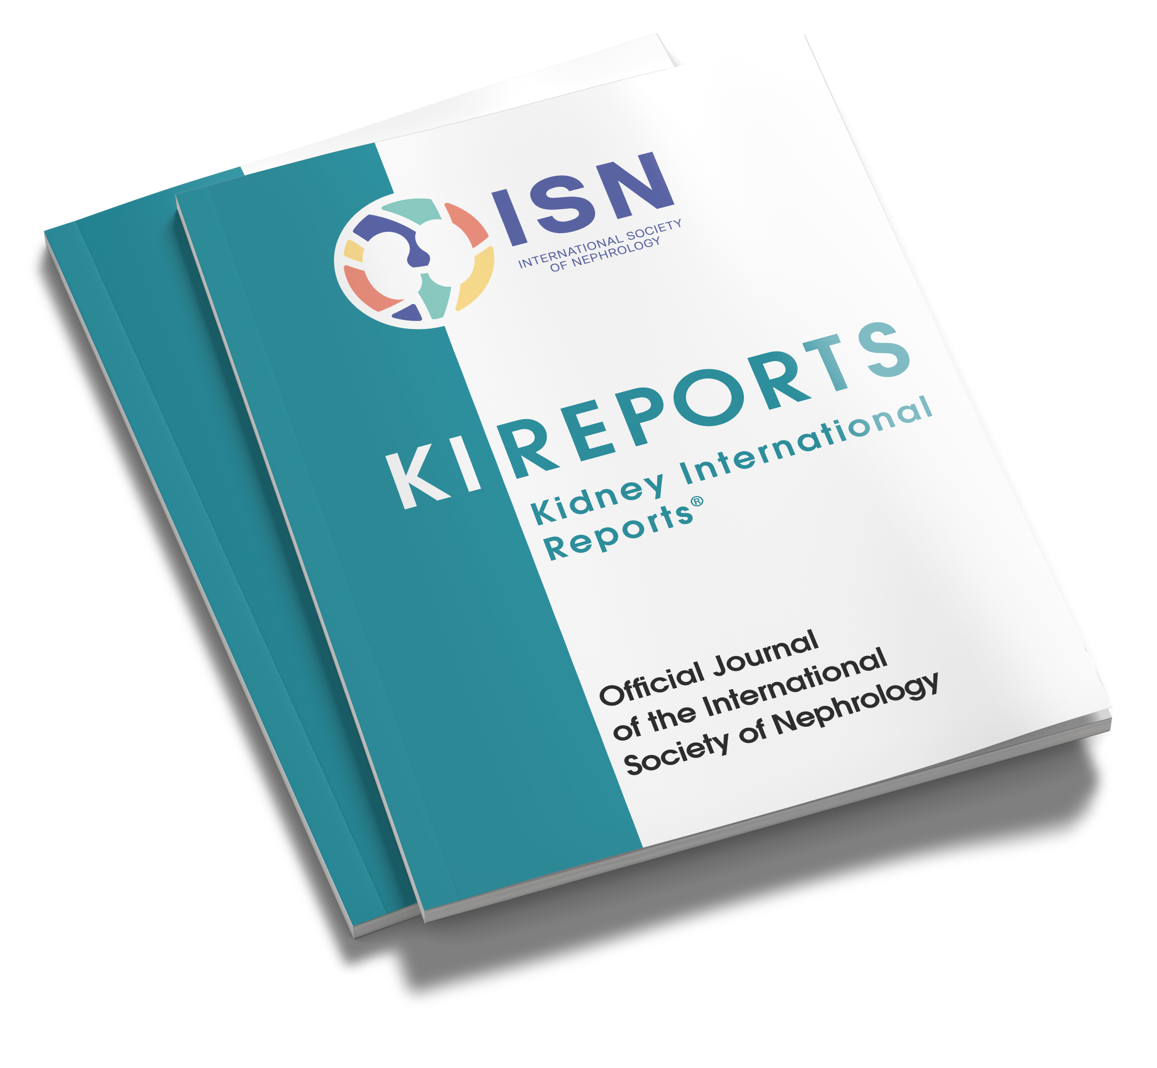
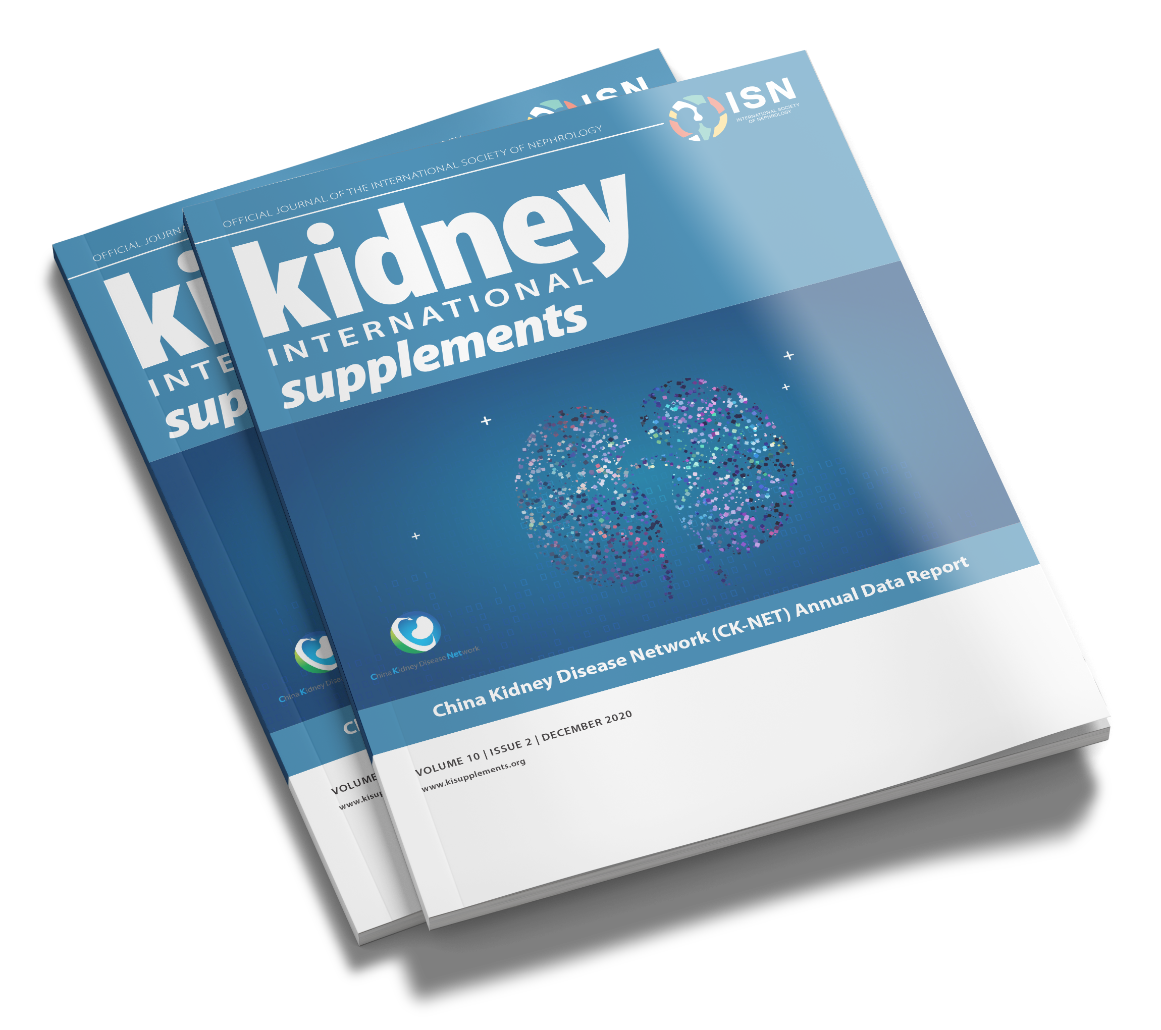


JOURNALS
2022 IMPACT FACTORS
19.6
6
5.5
*online open access
- In action

Slide 50
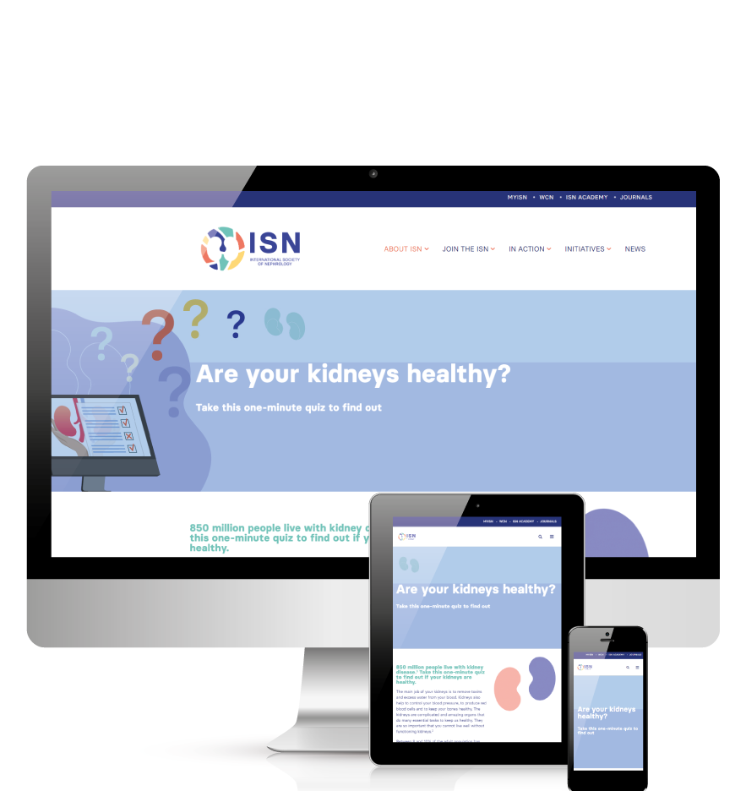
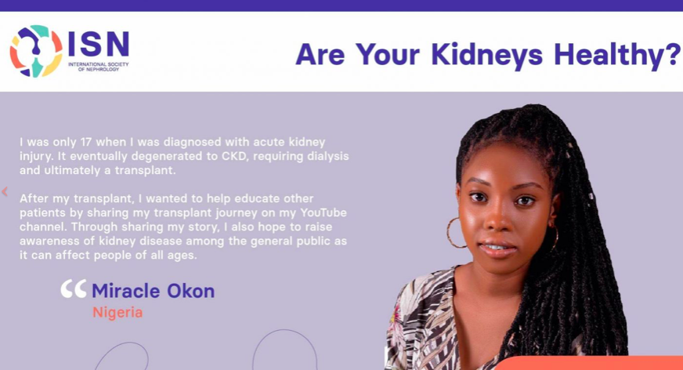
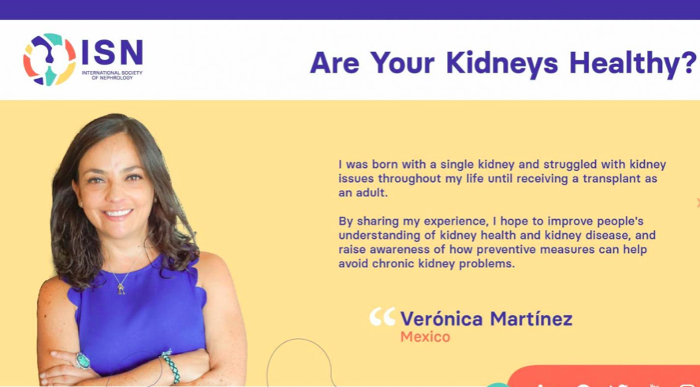
QUIZ: ARE YOUR KIDNEYS HEALTHY?
A one-minute quiz to help the general public learn more about chronic kidney disease and its risk factors
The quiz launched in March 2021. Since then, over 133,816 people have completed the quiz (data as of 31 May 2023)​
Now available in 17 languages, with more on the way!​​
Take the quiz and
share it alongside patient stories:
kidneyquiz.theisn.org
- Initiatives

Slide 51
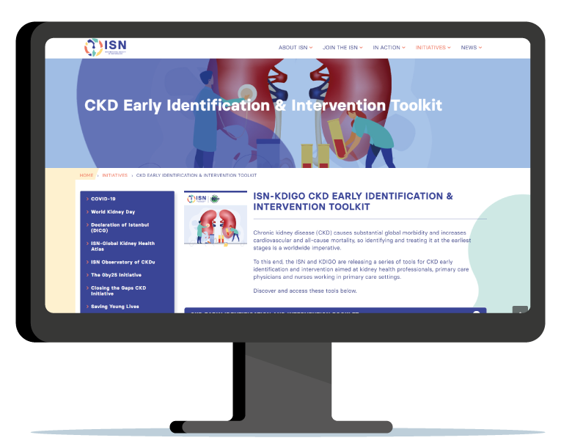
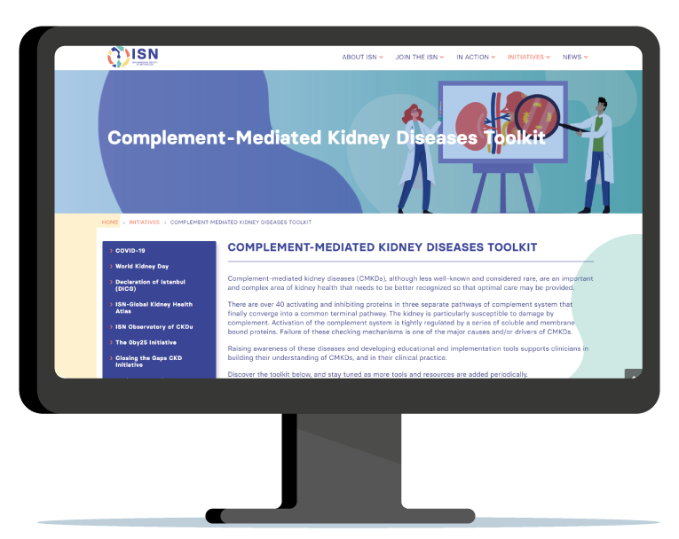
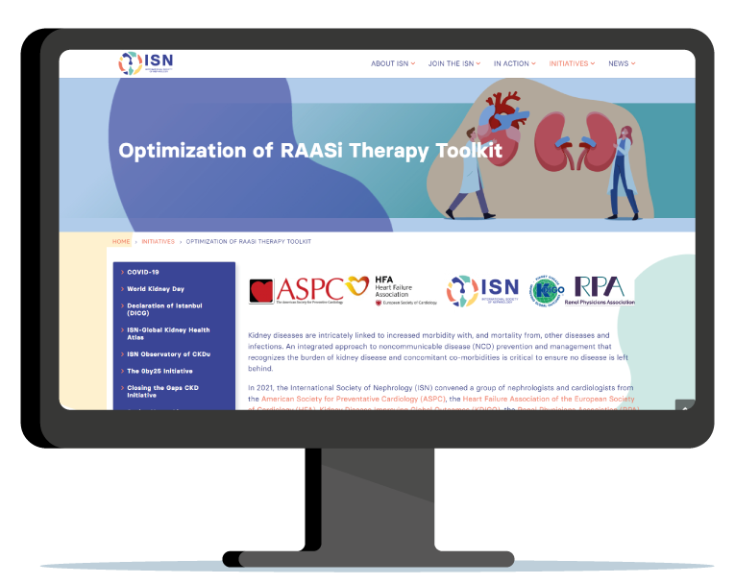
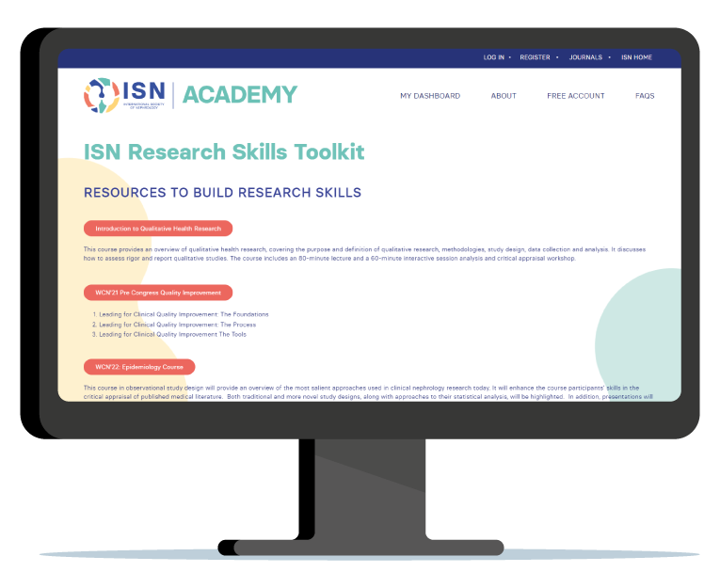
ISN TOOLKITS
ISN-KDIGO EARLY IDENTIFICATION AND INTERVENTION TOOLKIT
COMPLEMENT–MEDIATED KIDNEY DISEASES (CMKD) TOOLKIT
supports clinicians in building their understanding of CMKDs, and in their clinical practice.
aimed at kidney health professionals, primary care physicians and nurses working in primary care settings.
OPTIMIZATION OF RAASI THERAPY TOOLKIT
ISN RESEARCH SKILLS TOOLKIT
comprehensive compilation of research resources to support younger generations of nephrologists (and anyone else interested) to contribute to advancing kidney health worldwide.
for healthcare professionals involved in the multidisciplinary care of patients with cardio-renal complications. A joint cardiology – nephrology initiative.
theisn.org/toolkits

Slide 52

OUR SHARED RESPONSIBILITY – THE URGENT NECESSITY OF GLOBAL ENVIRONMENTALLY SUSTAINABLE KIDNEY CARE
GREEN-K – Global Environmental Evolution in Nephrology and Kidney Care – calls on the development of climate resilient kidney care systems that function through accountable, sustainable low carbon health care, and propose a pathway to achieve this goal through a global, collaborative, and inclusive multidisciplinary working group.
GREEN-K is an international, joint activity of leading national and regional kidney societies on environmentally sustainable kidney care through advocating for and educating in green nephrology to reduce the specialty's carbon footprint.
Explore resources:
theisn.org/green-k

Slide 53







www.theisn.org
Global Operations Center
Americas Operations Center
Avenue des Arts 1-2
1210 Brussels, Belgium
340 North Avenue 3rd Floor
Cranford, NJ 07016-2496, United States
+ 32 2 808 04 20
+1 904 345 0866
info@theisn.org
info@theisn.org
Follow us

